Slide 1
Booking App 1
Professor Jianqing (Fisher) Wu

Slide 2
Overview
Create an app with two tabs
Store and Use Data in Service
Show Images on Cards and Items
Create “Offers” tab to list offered places
Use CSS to Style

Slide 3
Create a New App with Tabs
Run “ionic start beachbnb tabs” command to generate an app with tabs.
Open “beachbnb” folder.
Run “ionic serve” command to start emulation.
Delete “tab3” folder.
Remove “tab3” codes in “tabs.page.html” and “tabs-routing.module.ts”

Slide 4
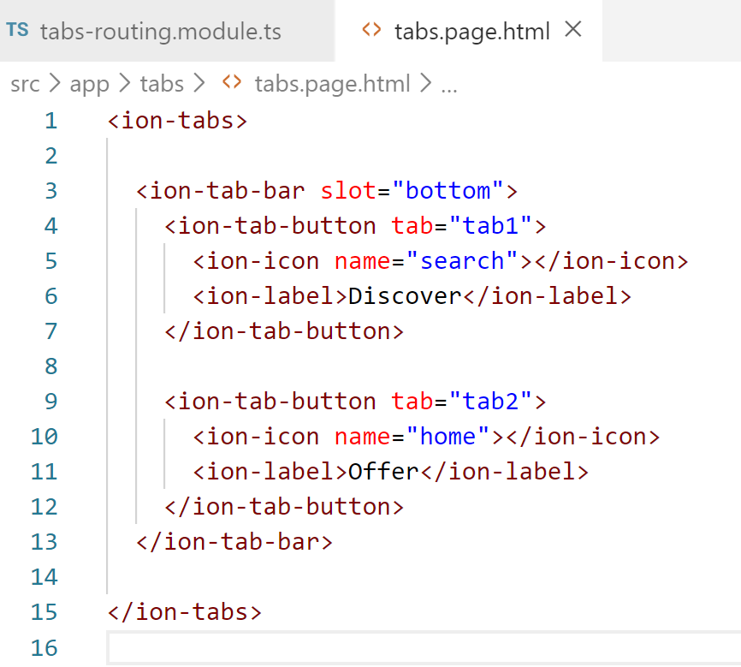
Change the Tab Bar
Change the icons and words in the tab bar by editing “tabs.page.html” file

Slide 5
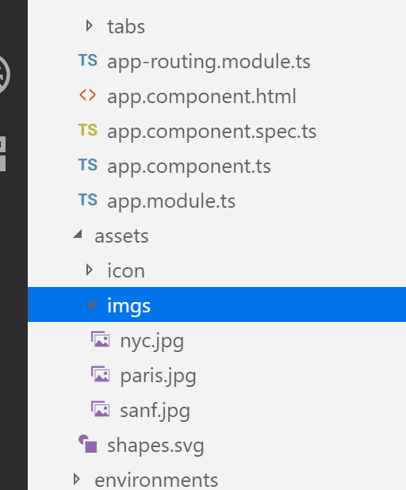
Copy Images to “assets” Folder
Right click “assets” folder, then click “New Folder”. Name it “imgs”. Copy/paste the images you download from BeachBoard to “imgs” folder.

Slide 6
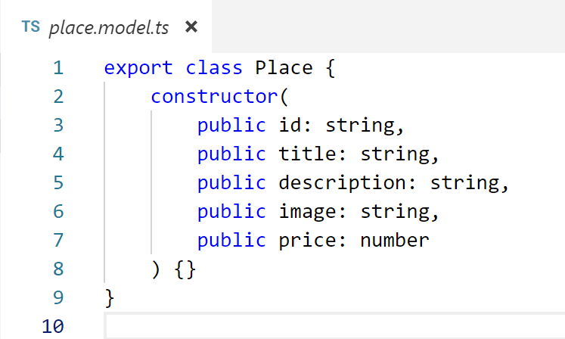
Store and Use Data in Service
Right click “tab1” folder, then click “New File”. Name it “place.model.ts”. Edit it as follows to define a data type “Place”.

Slide 7
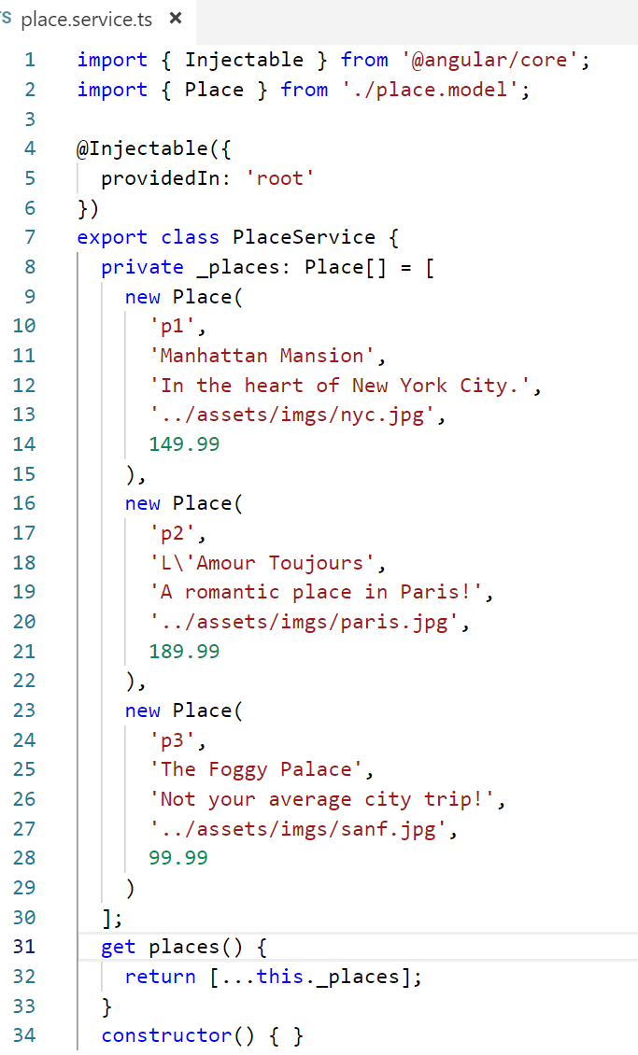
Store and Use Data in Service
Run “ionic g service tab1/place” command to generate service files under tab1 folder. Edit “place.service.ts” as follows.

Slide 8
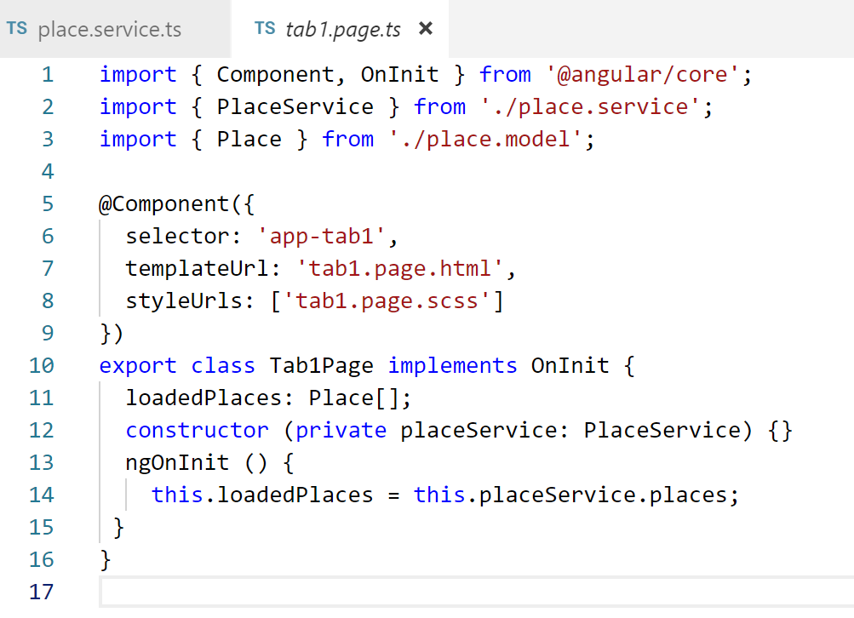
Import Data from Service
To get data from the service file, edit “tab1.page.ts” file as follows.

Slide 9
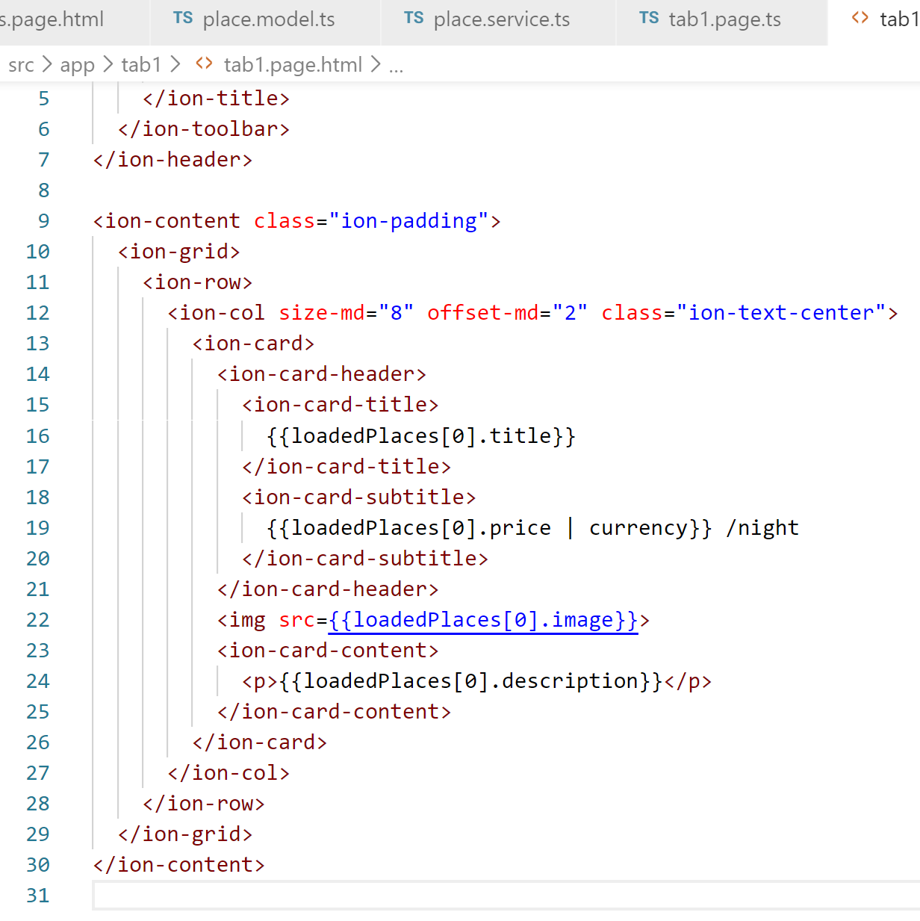
Show the Featured Place as a Card on “tab1”
Edit “tab1.page.html” as follows

Slide 10
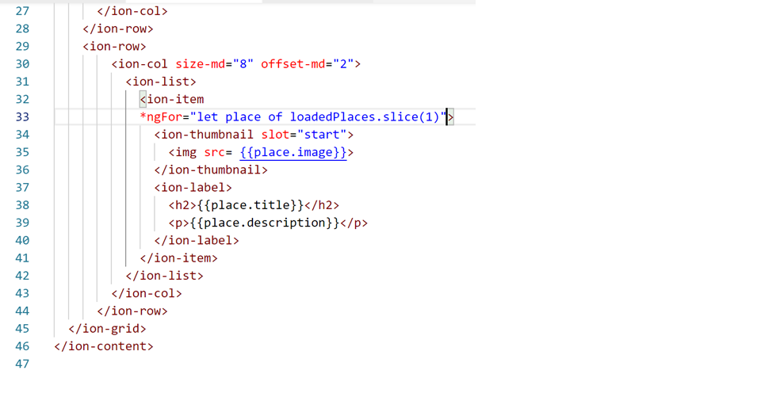
Show Other Places as Items on “tab1”
Continue to edit “tab1.page.html” as follows

Slide 11
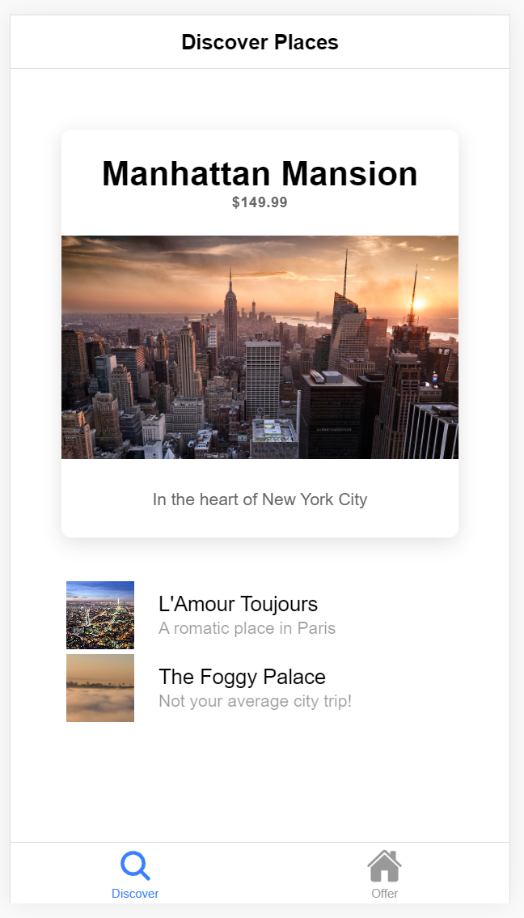
Emulation
You will see the following “Discover” tab.

Slide 12
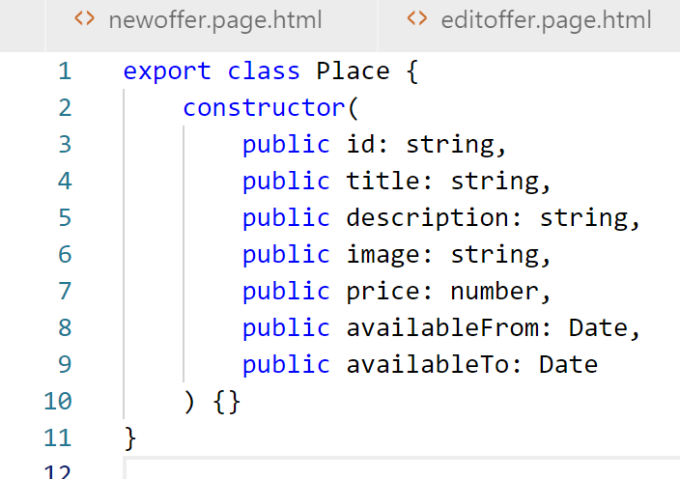
Add Available Dates for Each Place
Edit “place.model.ts” as follows.

Slide 13
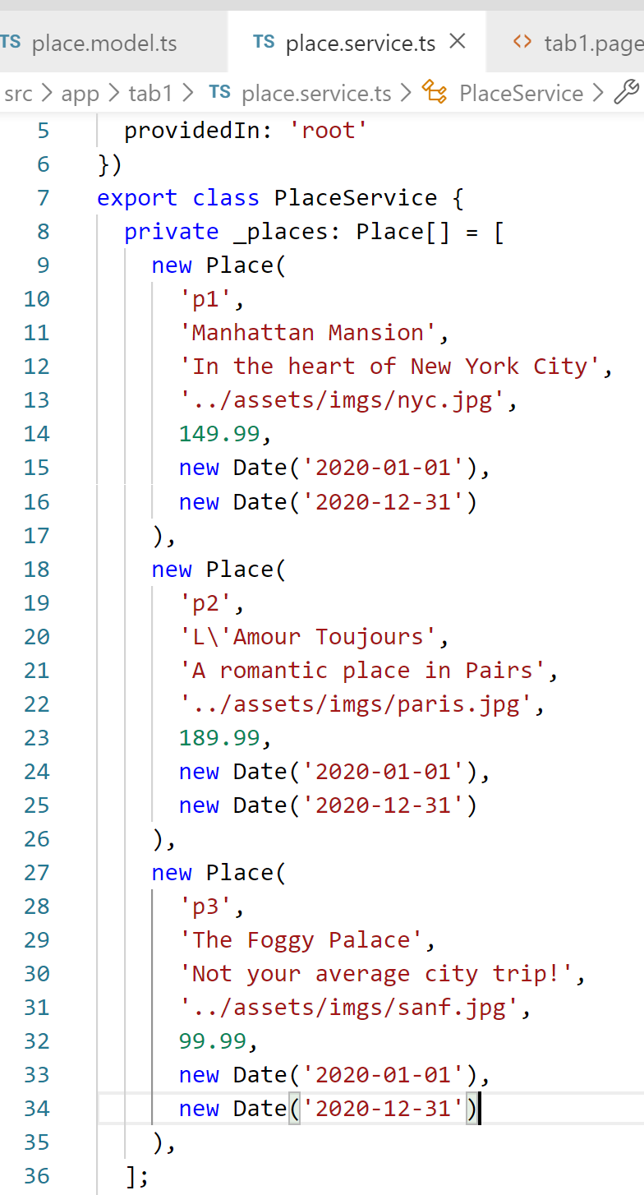
Add Available Dates for Each Place
Edit “place.service.ts” as follows.

Slide 14
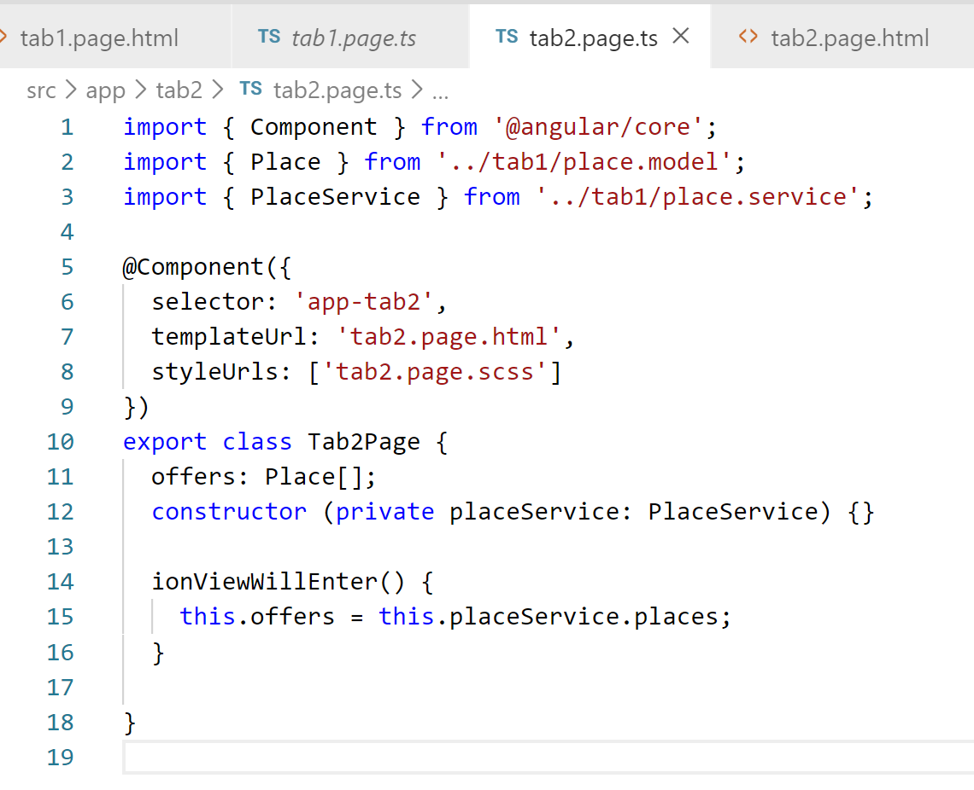
Import Data from Service to “tab2”
To get data from the service file, edit “tab2.page.ts” file as follows.

Slide 15
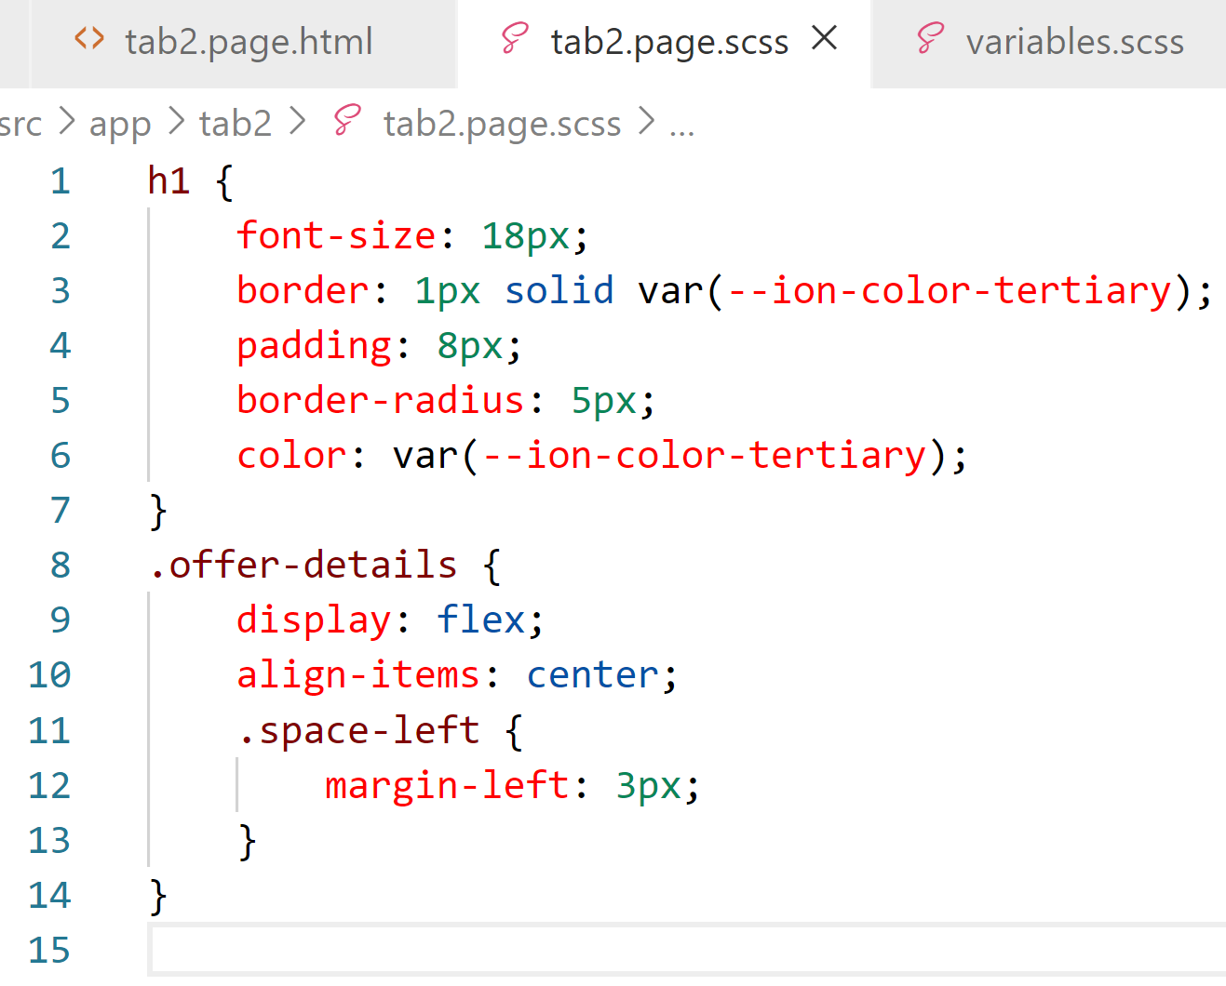
Setup Display Formatting and Styling
To define styling of how to display offer information , edit “tab2.page.scss” file as follows.

Slide 16
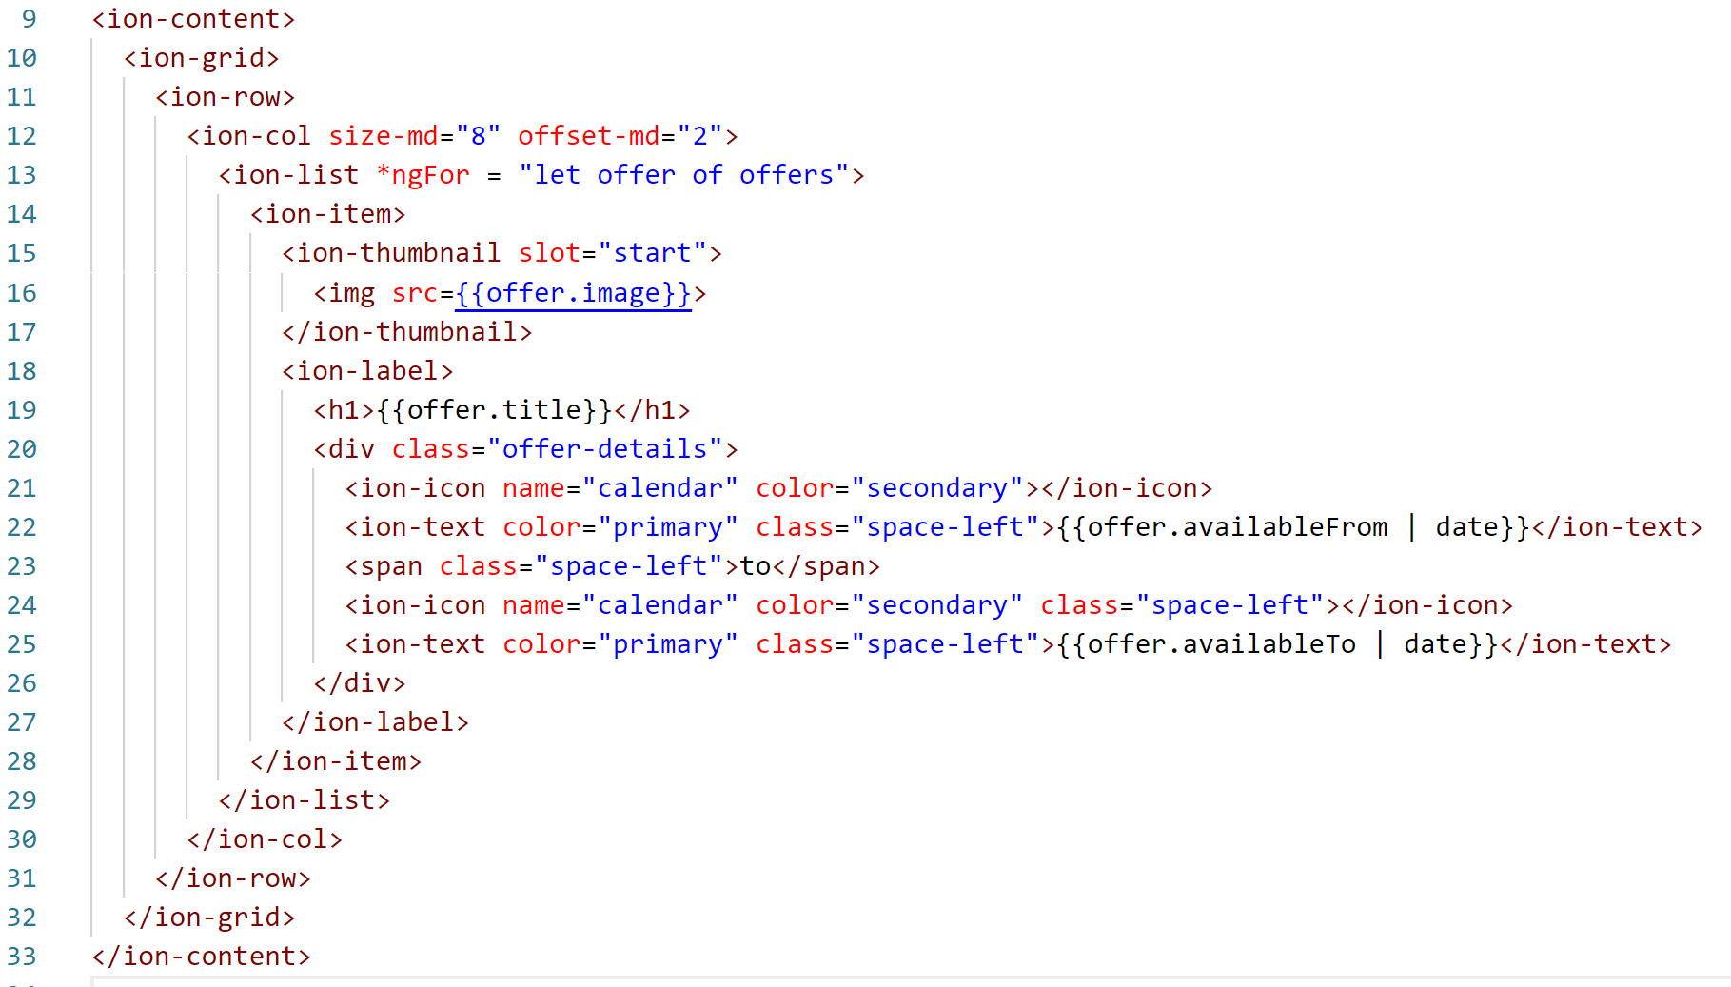
Show the Place as Items on “tab2”
Change the ion-title of “tab2.page.html” to “Offers” and edit it as follows

Slide 17
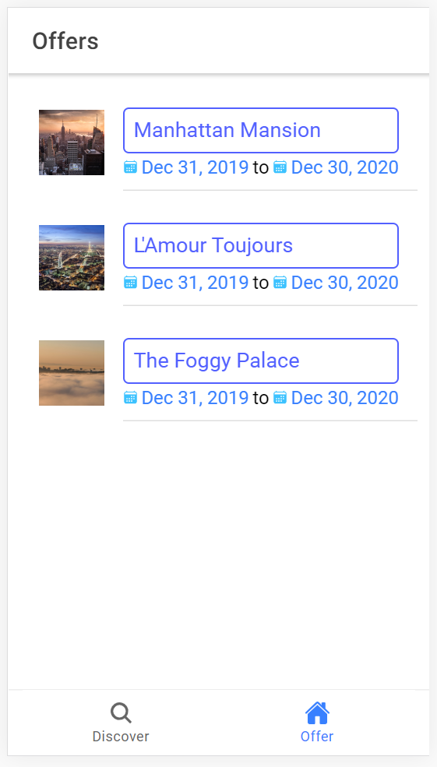
Emulation
You will see the following “Offer” tab. Notice: Displayed dates may be different with the ones in the data file because of time zone.

